Slide 1


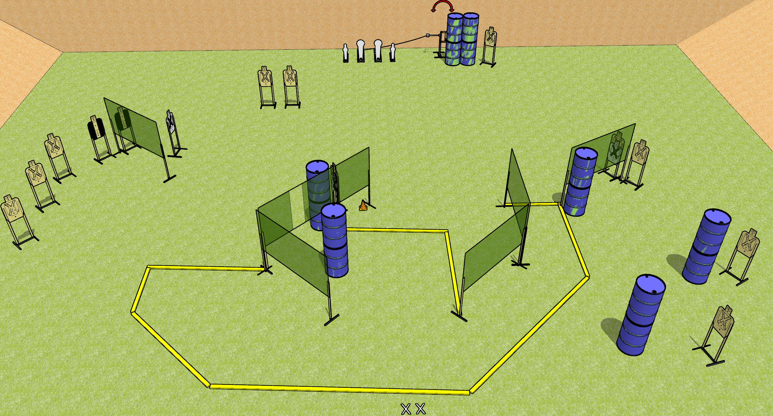
 | Dothan Gun Club – USPSA Match Single Stack Friendly Course Designer : Drew Coleman
START POSITION : Standing with both feet on X’s, wrists below belt
GUN READY CONDITION : Pistol loaded and holstered. PCC loaded, shouldered, safety on, pointed at orange cone. |  | SCORING: Comstock, 32 rounds TARGETS: 14 paper, 4 Steel SCORED HITS: Best 2 on paper, steel until down START-STOP: Audible, last shot RULES:
STAGE PROCEDURE: Engage targets as they become available from within the fault lines.

Slide 2
Single Stack Friendly
Written Stage Briefing
Single Stack Friendly is a 32 round, 160 point, Comstock field course. There are fourteen USPSA targets, two Colt poppers, and two mini poppers. The best two hits on paper will score, and steel must fall to score. The start signal is audible.
The swinger is activated by either Colt popper. Check the activator setup prior to activating during walkthrough and reset it the same way each time.
Handgun start position is standing with both feet on X’s, wrists below belt. Handgun is loaded and holstered.
PCC start position is standing with both feet on X’s. Loaded carbine is held with both hands, shouldered, safety on, pointed at orange cone.
On start signal, engage targets from within the fault lines.

